Slide 1
LIBRARY MANAGEMENT SYSTEM
Gowsika n
gowsika p
hari Prasanna s

Slide 2
PROBLEM STATEMENT
Libraries serve as vital hubs for knowledge dissemination and resource sharing. However, managing the extensive operations involved in a library—such as book cataloging, user records, borrowing and returning of books—often becomes cumbersome, particularly when relying on manual processes. The traditional manual system of maintaining registers or spreadsheets for tracking books and user information is not only time-consuming but also prone to errors.

Slide 3
OBJECTIVE
To create an E-Library Management System where the user has the following options:
Add book
Lend a book
Return a book
Display available book

Slide 4
CHALLENGES
1. Data Errors: Frequent errors in recording book issuances, returns, and user details can lead to discrepancies in the inventory.
2. Resource Mismanagement: Books may be misplaced, over-issued, or not properly accounted for due to lack of real-time updates.
3. Time-Consuming Processes: Manual processes for issuing or returning books, checking availability, and managing fines are slow and inefficient.
4. Limited Accessibility: Records maintained in physical registers are not easily accessible or retrievable, leading to delays in service.
5. User Dissatisfaction: Slow services and errors often frustrate users, reducing the library’s overall efficiency and reputation.

Slide 5
SOURCE CODE
import java.util.*;
// Book Class
class Book {
int bookId;
String title;
String author;
String isbn;
int availableCopies;
int totalCopies;
public Book(int bookId, String title, String author, String isbn, int totalCopies) {
this.bookId = bookId;
this.title = title;
this.author = author;
this.isbn = isbn;
this.availableCopies = totalCopies;
this.totalCopies = totalCopies;
}
}

Slide 6
// User Class
class User {
int userId;
String name;
String email;
String password;
String role;
public User(int userId, String name, String email, String password, String role) {
this.userId = userId;
this.name = name;
this.email = email;
this.password = password;
this.role = role;
}
}

Slide 7
class BookManagement {
private Map<Integer, Book> books = new HashMap<>();
private int bookCounter = 1;
public void addBook(String title, String author, String isbn, int totalCopies) {
Book book = new Book(bookCounter++, title, author, isbn, totalCopies);
books.put(book.bookId, book);
System.out.println("Book added successfully.");
}
public void searchBook(String title) {
books.values().stream()
.filter(book -> book.title.toLowerCase().contains(title.toLowerCase()))
.forEach(book -> System.out.println("Book ID: " + book.bookId +
", Title: " + book.title + ", Author: " + book.author +
", Available Copies: " + book.availableCopies));
}

Slide 8
public void listAllBooks() {
books.values().forEach(book -> System.out.println("Book ID: " + book.bookId +
", Title: " + book.title + ", Author: " + book.author +
", Available Copies: " + book.availableCopies));
}
public void viewOnlineCatalog() {
System.out.println("Online Catalog:");
books.values().forEach(book -> System.out.println("Book ID: " + book.bookId +
"\nTitle: " + book.title + "\nAuthor: " + book.author +
"\nISBN: " + book.isbn + "\nAvailable Copies: " + book.availableCopies +
"\nTotal Copies: " + book.totalCopies + "\n------------------------------"));
}
public Book getBookById(int bookId) {
return books.get(bookId);
}
}

Slide 9
// Book Management Class
// User Management Class
class UserAccountManagement {
private Map<Integer, User> users = new HashMap<>();
private int userCounter = 1;
public void addUser(String name, String email, String password, String role) {
User user = new User(userCounter++, name, email, password, role);
users.put(user.userId, user);
System.out.println("User added successfully.");
}
public User getUserById(int userId) {
return users.get(userId);
}
}
// Borrowing System Class
class BorrowingSystem {
private Map<Integer, Integer> borrowedBooks = new HashMap<>();

Slide 10
public void borrowBook(UserAccountManagement userManagement, BookManagement bookManagement, int userId, int bookId) {
User user = userManagement.getUserById(userId);
Book book = bookManagement.getBookById(bookId);
if (user == null || book == null) {
System.out.println("Invalid user ID or book ID.");
return;
}
if (book.availableCopies > 0) {
book.availableCopies--;
borrowedBooks.put(bookId, userId);
System.out.println("Book borrowed successfully.");
} else {
System.out.println("No copies available for borrowing.");
}
}

Slide 11
public void returnBook(BookManagement bookManagement, int bookId) {
Book book = bookManagement.getBookById(bookId);
if (book == null || !borrowedBooks.containsKey(bookId)) {
System.out.println("Invalid book ID or the book was not borrowed.");
return;
}
book.availableCopies++;
borrowedBooks.remove(bookId);
System.out.println("Book returned successfully.");
}
}
// Main Class
public class Main {
public static void main(String[] args) {
Scanner scanner = new Scanner(System.in);
BookManagement bookManagement = new BookManagement();
UserAccountManagement userManagement = new UserAccountManagement();
BorrowingSystem borrowingSystem = new BorrowingSystem();

Slide 12
while (true) {
System.out.println("Library Management System");
System.out.println("1. Add Book");
System.out.println("2. Search Book");
System.out.println("3. List All Books");
System.out.println("4. Add User");
System.out.println("5. Borrow Book");
System.out.println("6. Return Book");
System.out.println("7. View Catalog");
System.out.println("8. Exit");
System.out.print("Select an option: ");
int choice = scanner.nextInt();
switch (choice) {

Slide 13
case 1 -> {
scanner.nextLine();
System.out.print("Enter title: ");
String title = scanner.nextLine();
System.out.print("Enter author: ");
String author = scanner.nextLine();
System.out.print("Enter ISBN: ");
String isbn = scanner.nextLine();
System.out.print("Enter total copies: ");
int totalCopies = scanner.nextInt();
bookManagement.addBook(title, author, isbn, totalCopies);
}
case 2 -> {
scanner.nextLine();
System.out.print("Enter book title to search: ");
String searchTitle = scanner.nextLine();
bookManagement.searchBook(searchTitle);
}

Slide 14
case 3 -> bookManagement.listAllBooks();
case 4 -> {
scanner.nextLine();
System.out.print("Enter name: ");
String name = scanner.nextLine();
System.out.print("Enter email: ");
String email = scanner.nextLine();
System.out.print("Enter password: ");
String password = scanner.nextLine();
System.out.print("Enter role (Admin/User): ");
String role = scanner.nextLine();
userManagement.addUser(name, email, password, role);
}
case 5 -> {
System.out.print("Enter user ID: ");
int userId = scanner.nextInt();
System.out.print("Enter book ID: ");
int bookId = scanner.nextInt();
borrowingSystem.borrowBook(userManagement, bookManagement, userId, bookId);
}

Slide 15
case 6 -> {
System.out.print("Enter book ID: ");
int bookId = scanner.nextInt();
borrowingSystem.returnBook(bookManagement, bookId);
}
case 7 -> bookManagement.viewOnlineCatalog();
case 8 -> {
System.out.println("Exiting...");
scanner.close();
return;
}
default -> System.out.println("Invalid option. Try again.");
}
}
}
}

Slide 16
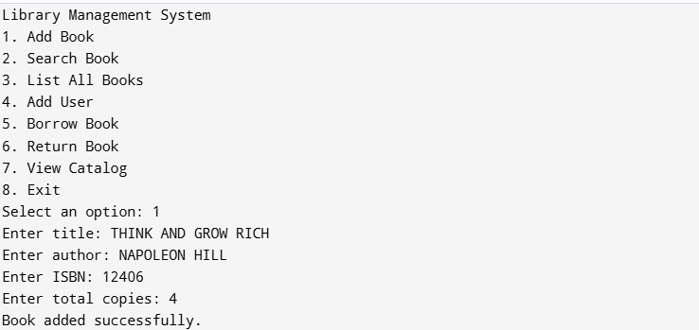
OUTPUT

Slide 17
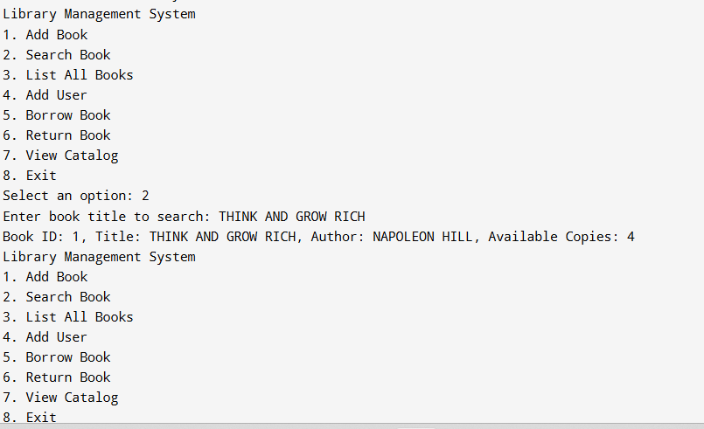

Slide 18
THANK
YOU

